Slide 1
design and implementation of a “njangi” application system
Members:
Chunke Blessing
Ousmanou Bouba
Ashu Brandon
Samme Samuel
Fuga Manguuue Francisco
Course instructor: Eng. KAH KISSINGER

Slide 2
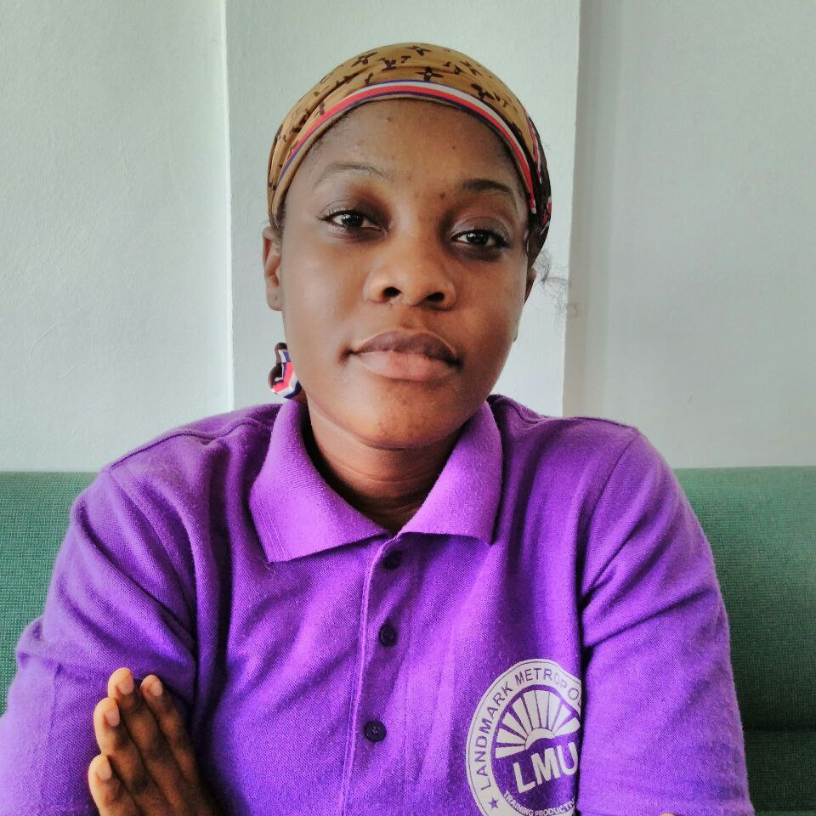
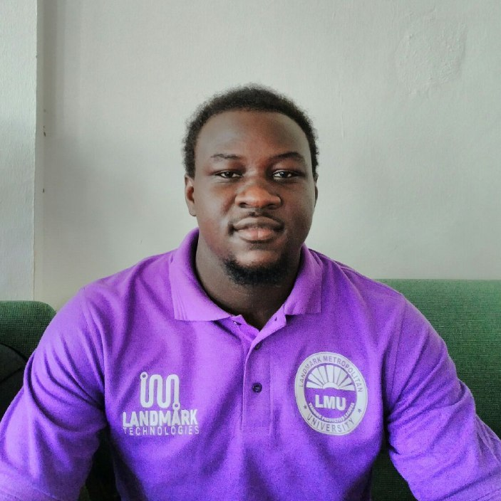
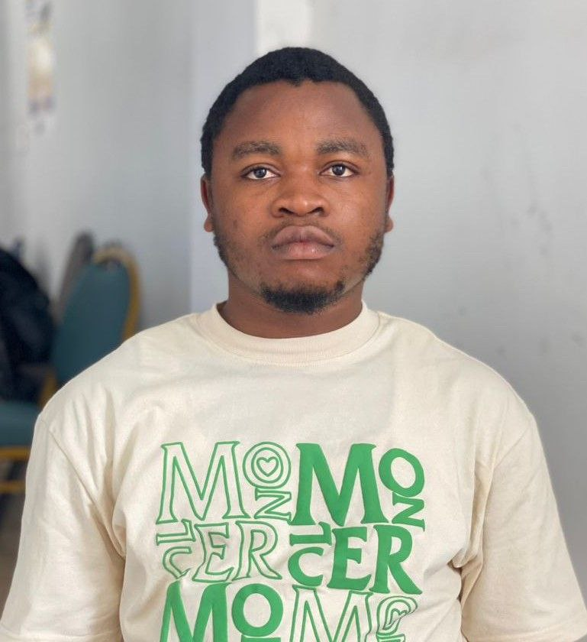
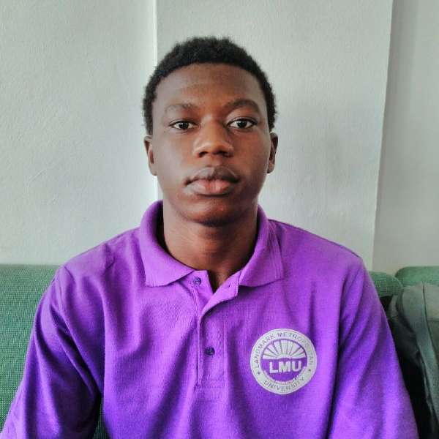
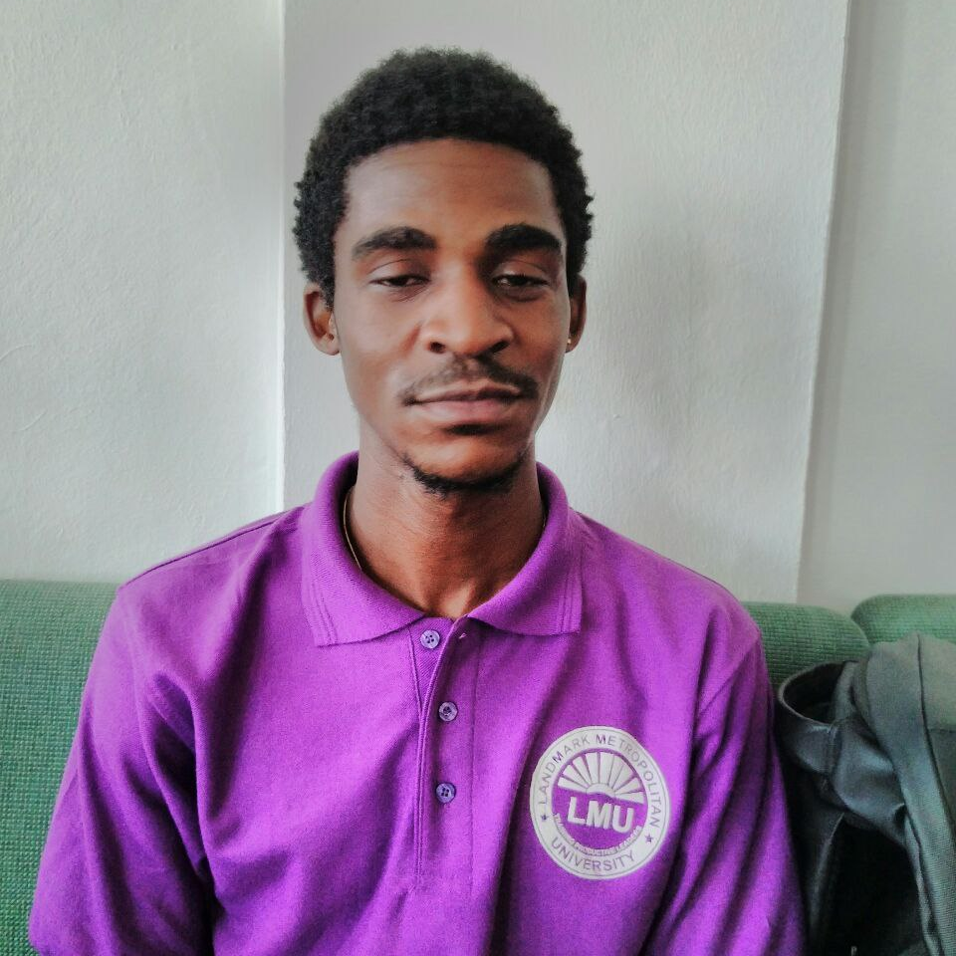
team
CHUNKE BLESSING
OUSMANOU BOUBA
FUGA MANGUE
SAMME SAMUEL
Research
Analysis Lead
Power point representation
UML diagrams
Documentation
Project Lifecycle
Figma representation

Slide 3
CONTENTS
Introduction
Objectives
Requirements
Project lifecycle
UML diagrams
Business Opportunities
Figma representation

Slide 4

INTRODUCTION
“NJANGI” is a contribution given to members in a rotating form at every sitting. In Addition, a “NJANGI” system helps members to carry out financial activities in a cultural and lovely manner with a good relationship with each members without having to pay for the services offered like what banks charges to it’s members .

Slide 5
objectives
User-Friendly Interface
Implementing a user-friendly and intuitive interface to streamline online onboarding, profile management and financial transactions

Slide 6
Implementing an automated secured system that depicts encryption protocols, secure payment gateways.
SECURITY

Slide 7
Cont…
Implementing an automated notification system for participants to make their contributions on time, reducing the likelihood of missed payments.
PAYMENT REMINDERS

Slide 8
Cont…
CONTRIBUTION TRACKING
Implementing the run-down and tracking of members contributions

Slide 9
FUNCTIONAL REQUIREMENTS
COMMUNICATION AND NOTIFICATION
The application should enable seamless communication amongst group members, it should not allow users to send messages, announcement, or alerts to the entire group or specific individuals unless under admin approval.

Slide 10
Cont…
2. REPORT AND ANALYTICS
The system automatically generates the amount of people that have sent money using the third party system(momo), and the treasurer follow up the process of sending the total amount to the beneficiary following best practices.

Slide 11

3. NJANGI GROUP CREATION
The admin initiates a new njangi group, providing the necessary group details to enhance better security, effective communication leading to a successful group work

Slide 12
4. USER REGISTRATION AND AUTHENTICATION -Admin creates user accounts and provides them with login credentials(password and username) for them to easily have access to the application
Once in the application users can navigate through the dashboard to perform activities

Slide 13


Non-FUNCTIONAL REQUIREMENTS
The application should be able to handle a significant number of significant users and transactions , the application will be set to place a fine to members who borrow from the njangi with a maximum loan of 100,000frs and do not repay on time and also to contributions that are not made on time , also the app will manage the contributions made in case any incidence happens to the members closest family member such as in case of deaths ,marriages , births.

Slide 14
Non-FUNCTIONAL REQUIREMENTS
SECURITY MEASURES
The application should have robust security measures in place to protect user data ,transactions, and sensitive information this may include authentication , intrusion detection and intrusion prevention systems , encryption and authorization mechanisms

Slide 15
Non-FUNCTIONAL REQUIREMENTS
RELIABILITY
The application should be reliable and available to use at all times ,it should have a minimal downtime and should backups and should be able to recover quickly from any failures or errors

Slide 16
Cont…
SCALABILITY
The application should be able to accommodate growth and handle an increasing number of users and njangi groups without any significant problem, Also the app should accommodate members with multiple heads ( contributing units) at most 3 at a time..

Slide 17
Cont…
DATA PRIVACY
The application should comply with relevant data protection regulations and ensure the privacy and confidentiality of user data . it should also have appropriate data access controls and follow best practices for data storage and handling.

Slide 18
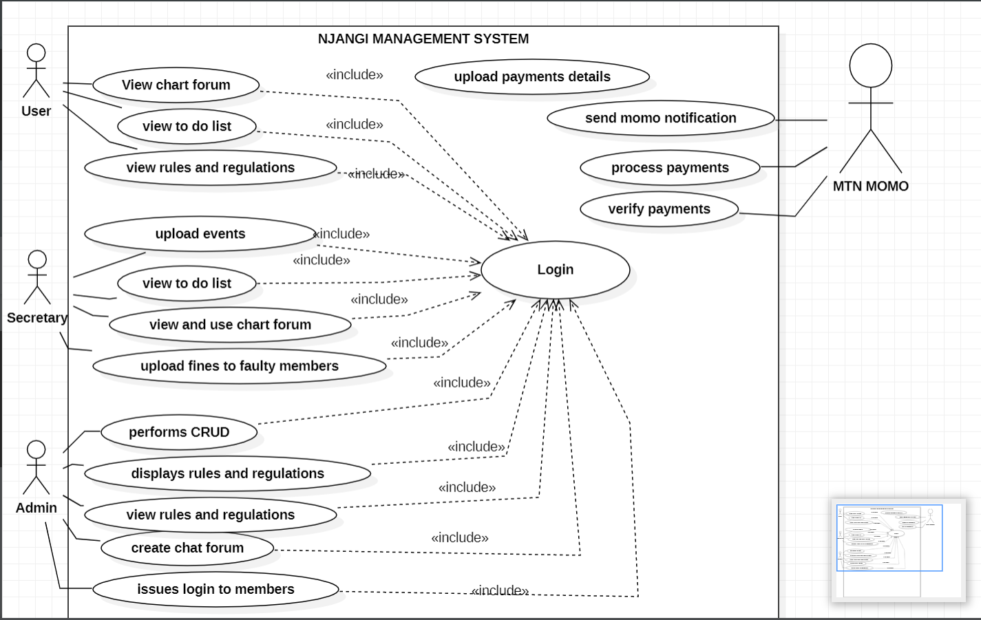
USE CASE DIAGRAM REPRESENATION

Slide 19
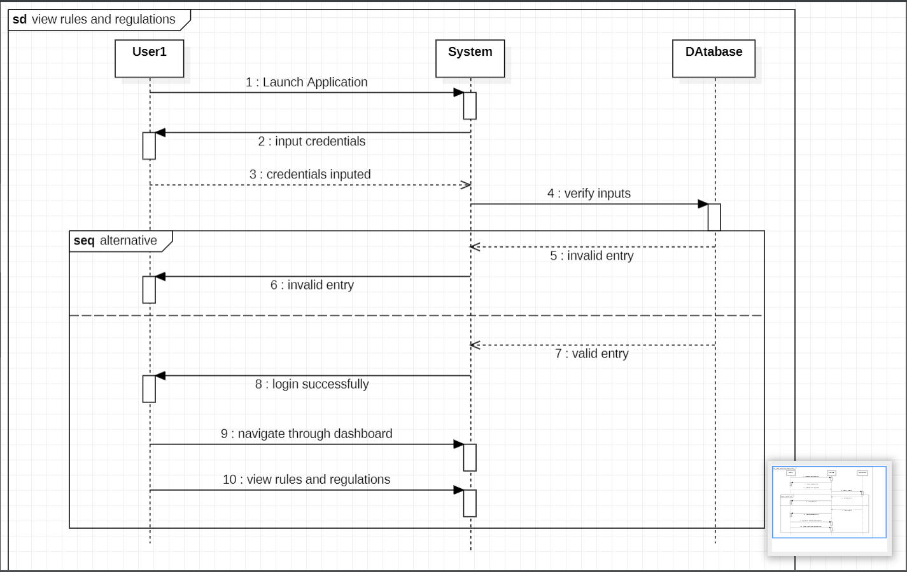
SEQUENCE DIAGRAM showing THE RULES AND REGULATIONS

Slide 20
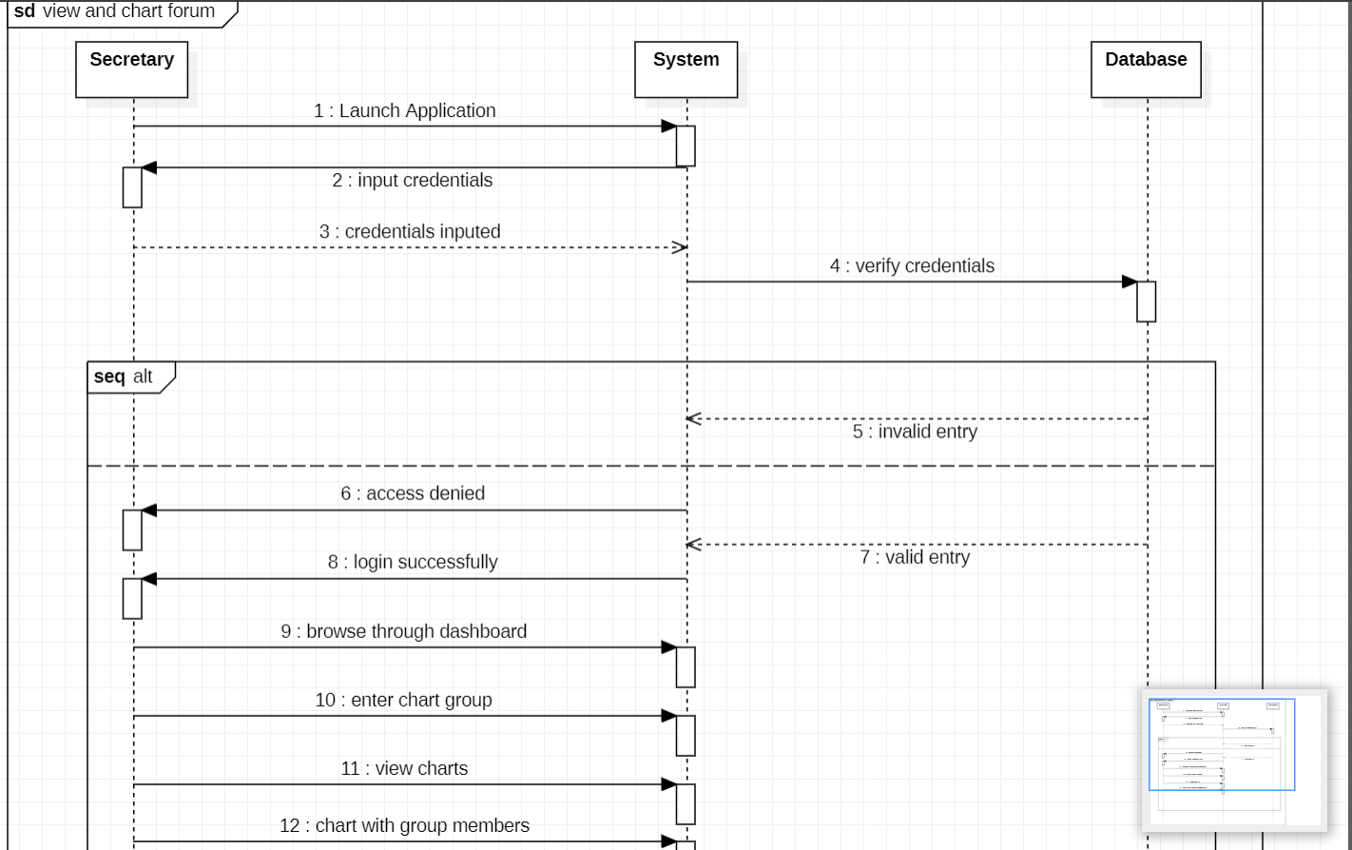
SEQUENCE DIAGRAM for SECRETARY CHARTING WITH GROUP MEEMBERS

Slide 21
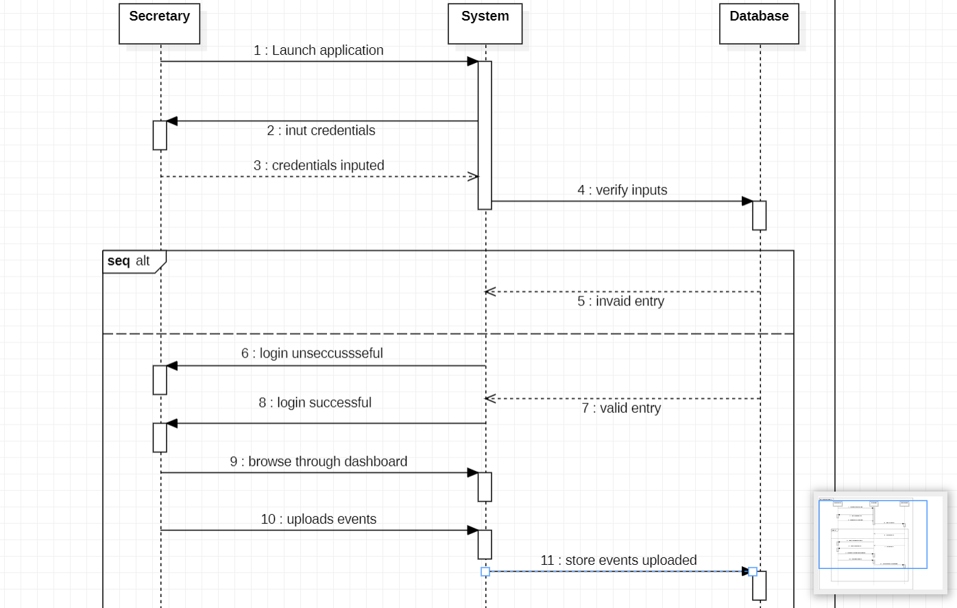
SEQUENCE DIAGRAM showing SECRETARY UPLOADING EVENTS

Slide 22
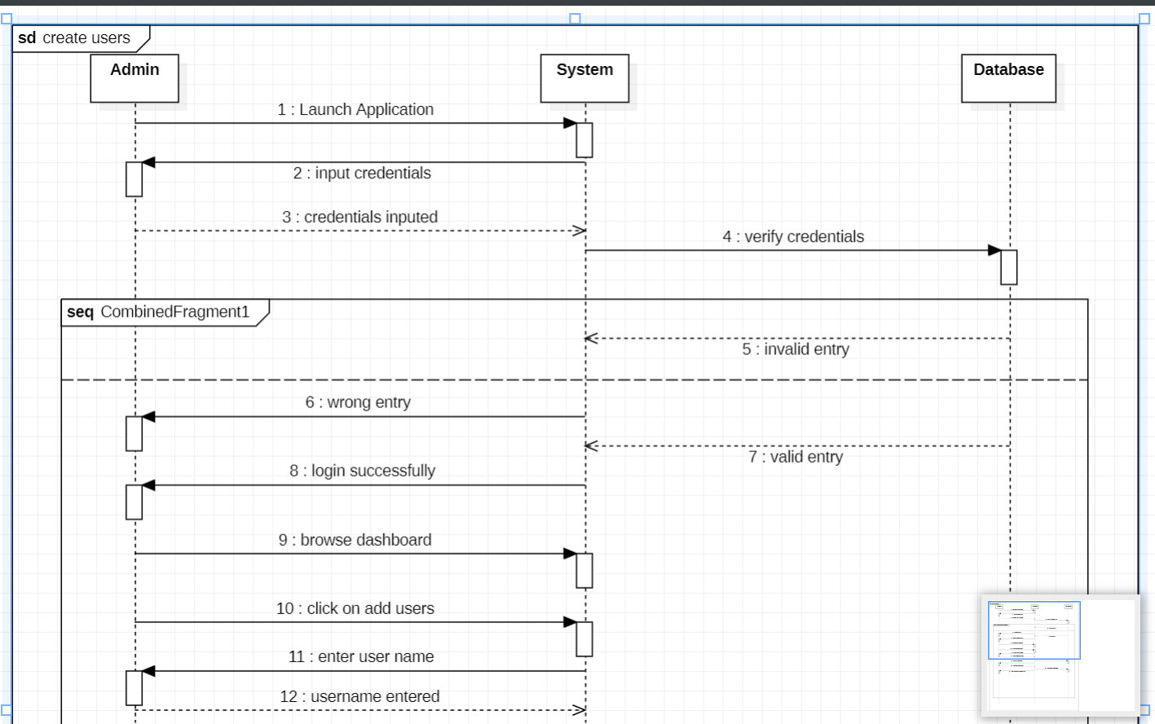
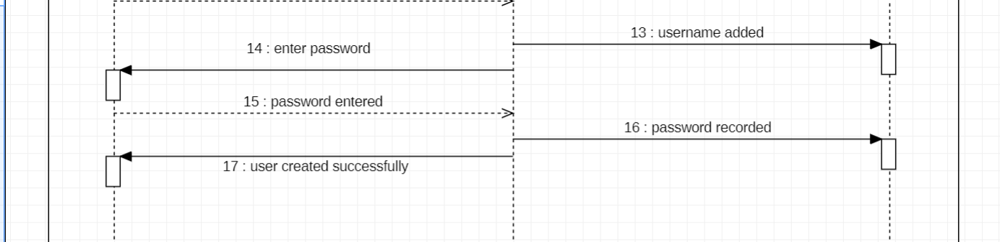

Slide 23
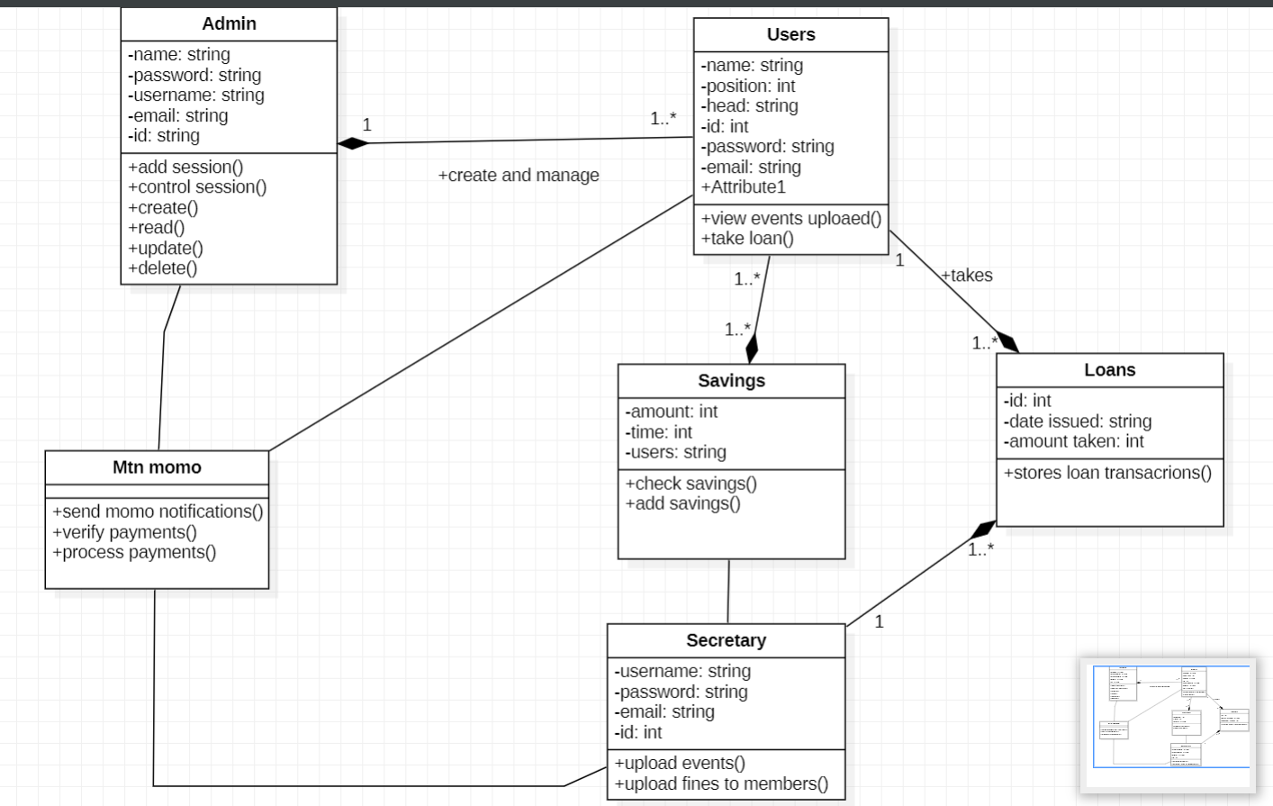
CLASS DIAGRAM REPRSENTATION FOR A NJANGI MANAGEMENT APPLICATION

Slide 24
BUSINESS OPPORTUNITIES
COMMUNITY BUILDING AND NETWORKING
You can establish an online community or forum where njangi participants can exchange ideas and share success stories and seek advice , monetization can be achieved through advertising, sponsored content or premium membership options
CONSULTING AND TRAINING
Providing consulting services on njangi management best practices, legal compliance, and financial literacy can be a viable business opportunities

Slide 25
SECURITY AND DATA PROTECTION
A business focusing on providing robust security measures, encryption and data protection services can find significant demand in this field .

Slide 26
Chart

Slide 27
Table
TOPIC 01 | TOPIC 02 | TOPIC 03 | TOPIC 04 | TOPIC 05
Item 01 | Text | Text | Text | Text
Item 02 | Text | Text | Text | Text
Item 03 | Text | Text | Text | Text
Item 04 | Text | Text | Text | Text
Item 05 | Text | Text | Text | Text
Item 06 | Text | Text | Text | Text
Item 07 | Text | Text | Text | Text
Item 08 | Text | Text | Text | Text
TOTAL | Text | Text | Text | Text

Slide 28

Thank you

